Slide 1

Support Vector Classifiers
A powerful approach to classification that finds the optimal separating boundary between classes using support vectors and mathematical precision.

Slide 2
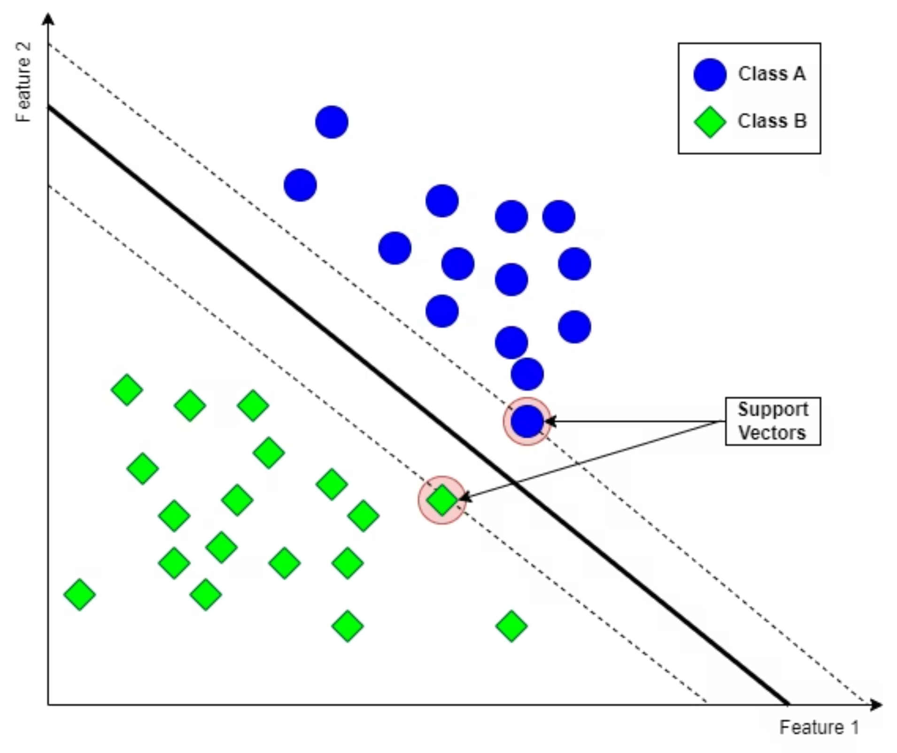
The Core Idea Behind SVCs
What Makes SVCs Unique
Support Vector Classifiers identify critical data points—called support vectors—that lie closest to the class boundary. These points define the strongest possible separating line or hyperplane.
By maximizing the margin between classes, SVCs create robust decision boundaries that generalize well to new data.

Slide 3












SVC Workflow: From Data to Decisions
Scale Data
Choose Kernel
Normalize features to ensure equal influence
Select linear, polynomial, or RBF transformation
Evaluate
Tune C
Assess performance metrics
Control margin flexibility
Train
Tune Gamma
Fit model to training data
Adjust decision boundary complexity

Slide 4
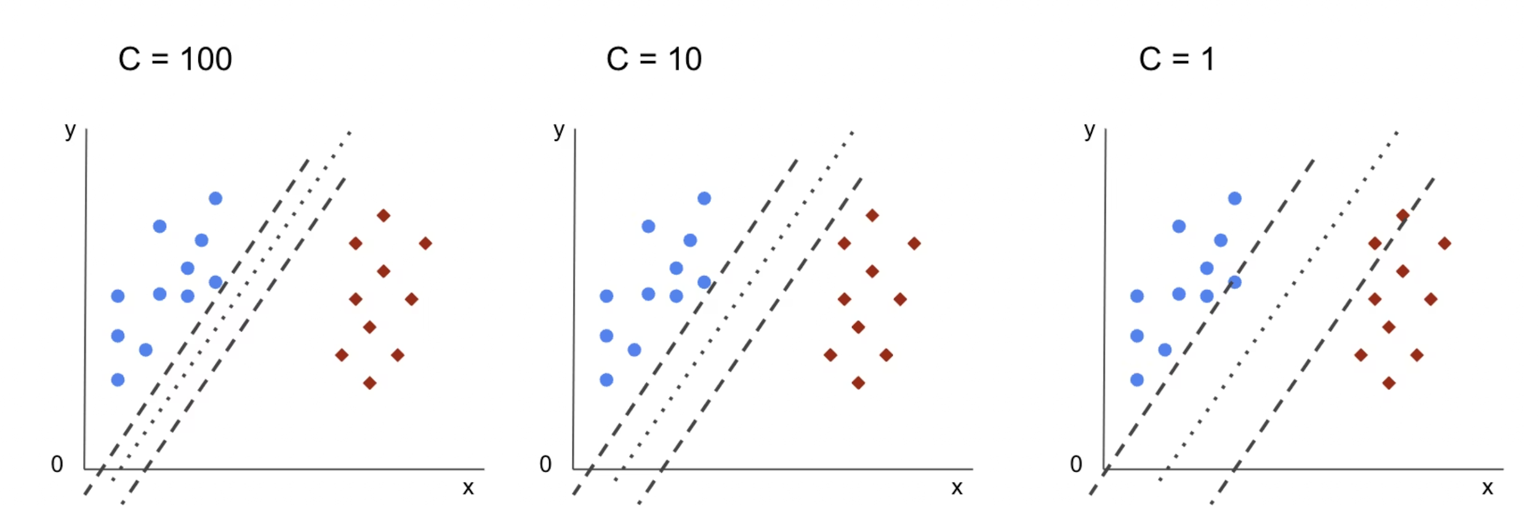
Understanding the C Parameter
High C Value
Low C Value
Strict Classification
Relaxed Margin
Creates a narrow margin with fewer misclassifications during training. The model prioritizes correct classification of all training points, potentially at the cost of generalization.
Allows a wider margin that tolerates some misclassifications. This softer approach often leads to better performance on unseen data by avoiding overfitting.
The C parameter controls the trade-off between achieving perfect training accuracy and maintaining model flexibility for better generalization.

Slide 5
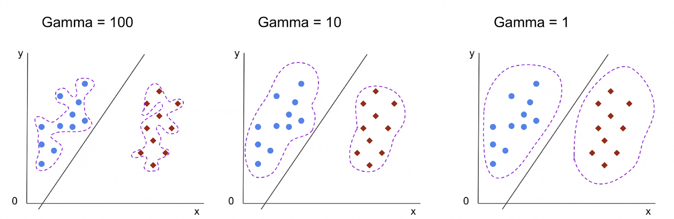
The Role of Gamma in RBF Kernels
Small Gamma
Large Gamma
Smooth Decision Boundary
Complex Decision Boundary
Points far from the boundary influence classification
Only nearby points influence classification
Creates simpler, more generalized models
Produces intricate, highly fitted boundaries
Lower risk of overfitting
Higher risk of overfitting training data

Slide 6
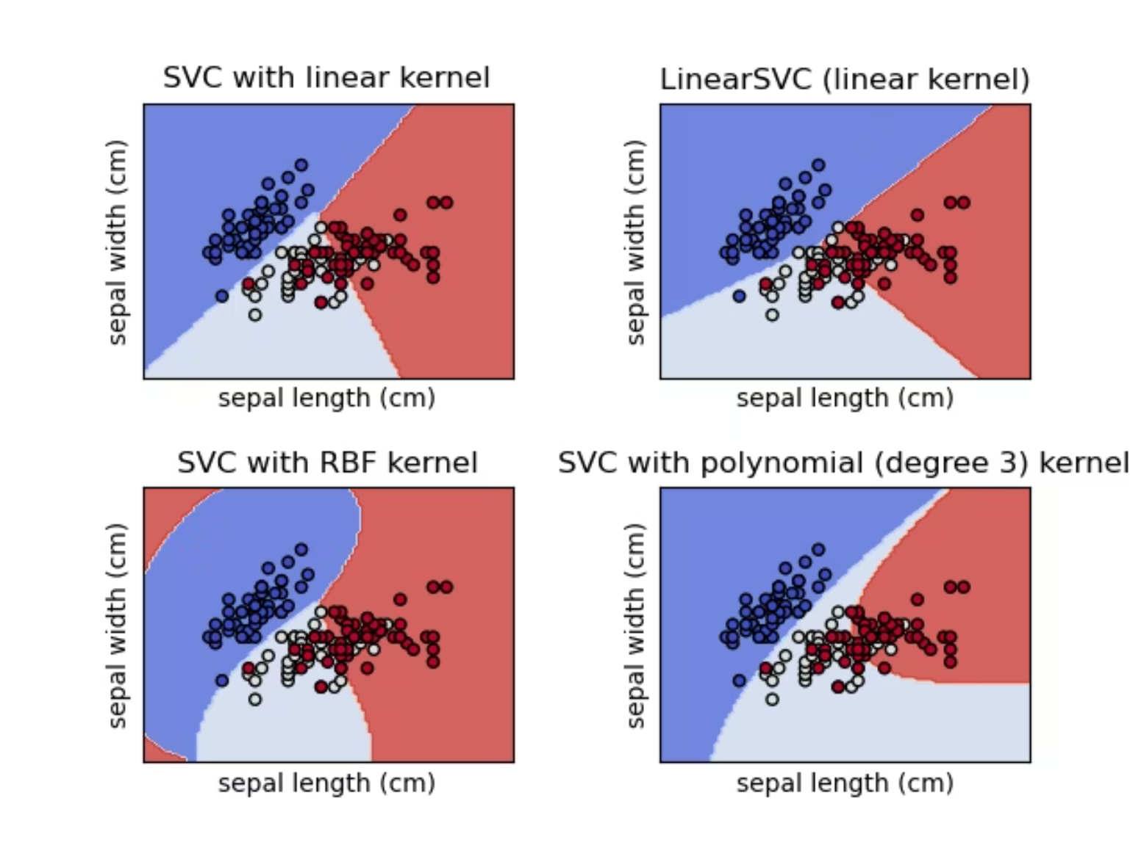
Kernel Comparison: Finding the Right Fit
Linear Kernel
Creates straight-line boundaries. Best for linearly separable data or high-dimensional spaces where simple patterns exist.
Use case: Text classification, when classes are clearly separated
Polynomial Kernel
Generates curved boundaries with polynomial curves. Suitable for moderately complex, non-linear patterns with controlled complexity.
Use case: Image recognition, pattern detection with predictable curves
RBF Kernel
Creates flexible, radial boundaries. The most versatile option for complex, non-linear relationships with no prior knowledge of data structure.
Use case: Most real-world problems, default choice for exploration

Slide 7


What's Next
You've Learned
Next: Hands-On Implementation
The core concepts of Support Vector Classifiers (SVC) for categorical prediction, emphasizing optimal decision boundaries.
Dive into practical application of SVC, implementing these powerful algorithms on real-world datasets to solve classification challenges.
Then: Support Vector Regression
Extend your knowledge to Support Vector Regression (SVR), applying the same powerful kernel methods to predict continuous numerical values effectively.

